Slide 1
Week of February 27, 2017
Current Events #26
February 27 837- The 15th sighting of Haley’s Comet
February 28, 1933- First female cabinet member appointed, Frances Perkins, Secretary of Labor
March 1, 1780- Pennsylvania becomes the 1st state to abolish slavery for newborns only
March 2, 1874- Baseball’s first batter’s box was adopted
March 3, 1791- Congress establishes US Mint
March 4, 1791- Vermont was admitted as the 14th state; 1st addition to the 13 colonies

Slide 2
National Toy Hall of Fame
2016 Inductees
The Strong’s National Toy Hall of Fame recognizes toys that have inspired creative play and enjoyed popularity over a sustained period. Each year, the hall inducts new honorees and showcases both new and historic versions of classic toys beloved by generations.
Criteria for Induction Inducted toys are selected on the basis of the following criteria: 1. Icon-status: The toy is widely recognized, respected, and remembered. 2. Longevity: The toy is more than a passing fad and has enjoyed popularity over multiple generations. 3. Discovery: The toy fosters learning, creativity, or discovery through play. 4. Innovation: The toy profoundly changed play or toy design. A toy may be inducted on the basis of this criterion without necessarily having met all of the first three.
Swing, Dungeons & Dragons, and Fisher-Price Little People
What toys would you induct and why?

Slide 3
Type of news item: International , National, State, Local or Business
An American icon is ending — the nearly 150-year old Ringling Bros. and Barnum & Bailey Circus announced over the weekend that its last show will be this May.
Some are sad … while others are cheering. Some feel like it’s the end of an era — that wholesome family entertainment steeped in history and tradition is coming to an end. Animal rights activist are happy, because they feel animals perform unnatural circus tricks is wrong.
Ticket sales are declining. There are also different kinds of circuses to choose from now, including ones that don’t use animals, such as Cirque du Soleil. There are also more and different kinds of entertainment than ever to choose from.
Perhaps it is the end of an era … but is it good or bad? What do you think? Should Sea World stop their shows as well?
http://www.mcall.com/features/family/92350770-132.html

Slide 4
Type of news item: International , National, State, Local or Business
Westminster Dog Show 2017:
Rumor the German Shepherd Wins Best in Show
A total of 2,908 dogs were entered in this year’s 141st annual Westminster Kennel Club Dog Show, consisting of 200 different breeds or varieties. “Best in Show” was awarded to a German Shepherd named Rumor. This is only 2nd time a German Shepherd has won!
The top dog got a gourmet steak and a trip to the top of the Empire State Building as part of her whirlwind victory lap on Wednesday.
Westminister was first held in 1877 and is America’s 2nd longest continuously held sporting event, behind only the Kentucky Derby which pre-dates the invention of the light bulb & the automobile, the building of the Brooklyn Bridge & the Washington Monument, the invention of basketball & the establishment of the World Series!
http://www.westminsterkennelclub.org/breed-results/breed-videos-2017/best-in-show-video/

Slide 5
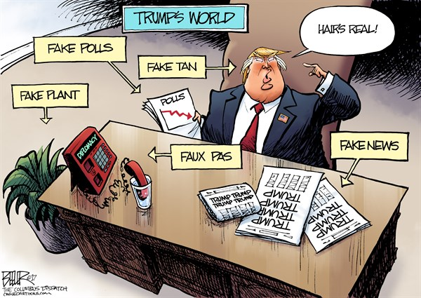
Thoughts???

