Slide 1
Week of Sept. 19, 2016
Current Events Wk #7
This week in history….
*September 19th, 1982 - first time use of the emoticon :-) online
*September 20th, 1893 - first gas-powered automobile is demonstrated
*September 21st, 1970 - Monday Night Football first airs on TV
*September 23rd, 1846 - the planet Neptune was discovered
*September 24th, 1936 - Jim Henson - muppets creator - was born

Slide 2
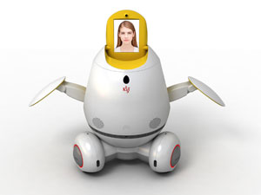
Type of news item: International, National, State, Local or Business
Is your teacher a robot??
Of course not! But she could be in the future according to Georgia Tech! In the spring, school officials pulled a fast one on students taking the Knowledge-Based Artificial Intelligence course. One of the teaching assistants, Jill Watson, was actually a robot!! A pool of questions and answers was created from previous courses and Jill was born! The robot will be back this fall but will go by a different name to see if students can identify it from the others.
Read more about Jill here!
What would the pros and cons be of robot teachers?

Slide 3
Type of news item: International , National, State, Local or Business
The Olympics Aren’t Over Just Yet...
You may have watched the Closing Ceremony
for the Olympics in Brazil but they aren’t completely
over. The Paralympics began on September 7th
and will come to a close this Sunday. These games
are for athletes with disabilities that prevent them from
competing in the tradition Olympic Games. Events are modified so
that all the athletes can participate. Read more here to find out how
our country is doing and learn about some of the athletes!
Check out some highlights from the Opening Ceremony!

Slide 4
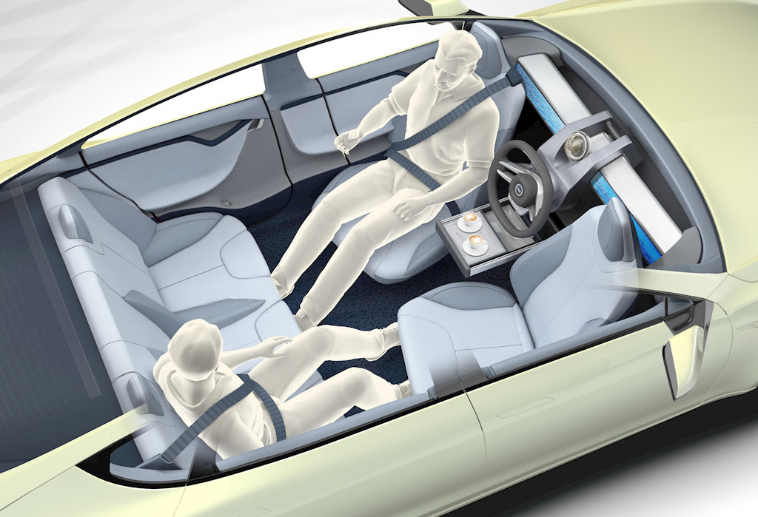
Type of news item: International, National, State, Local or Business
Driverless Cars: Yea or Nay?
Last year, we learned about a car
prototype that could drive itself.
As testing is expanding as well as
their popularity, what are your
thoughts on the issue? Check out
this PRO/CON article on Newsela
to help form your opinion.
Try a test ride in a self-driven car!!

Slide 5
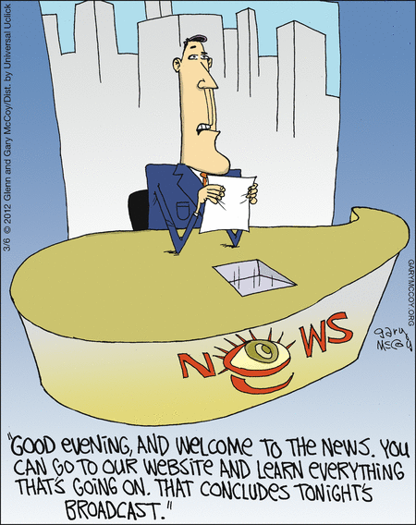
Thoughts?

Slide 6
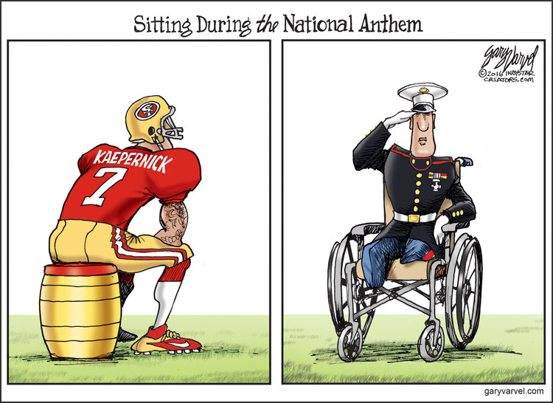
Thoughts?

