Slide 1
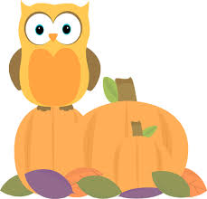
Week of October 31, 2016
Current Events Week 11
May your fall be filled with many things that make you think. Choose to be a wise owl!

Slide 2
Type of news item: International, National, State, Local or Business
Can children become famous artists?
Of course they can! Alita is a famous 9 year old girl from Australia with an amazing story. She began painting when she was still a toddler and has gone on to take the world by storm! As an abstract artist, Alita says she uses paint and the canvass to express her views of the world and her feelings. See the story here and then discuss the pros and cons of achieving this feat at such a young age:
http://abcnews.go.com/US/video/year-abstract-painter-opens-solo-show-famed-russian-42370422

Slide 3
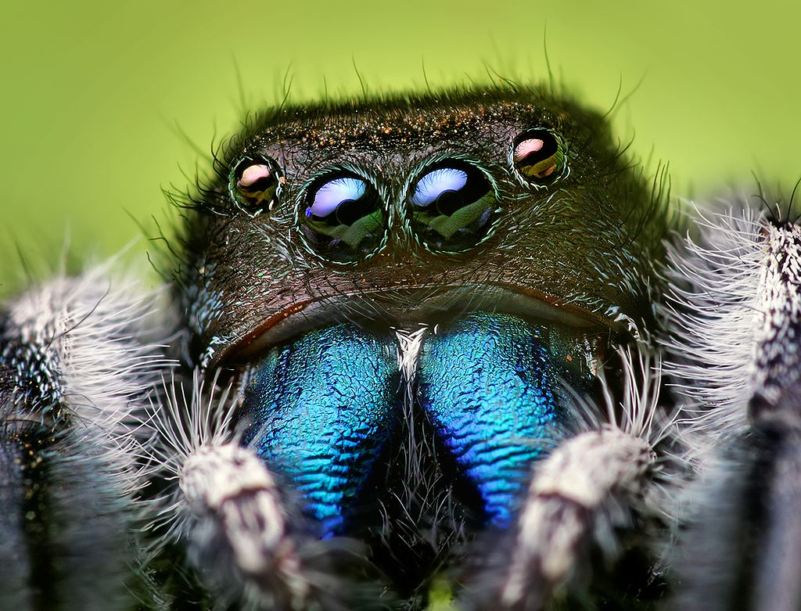
Type of news item: International, National, State, Local or Business
Afraid of spiders? Turns out that these creepy, crawly arachnids are able to ‘hear’ shrieks even though they have NO EARS! So how is this possible and how did researchers at Cornell University figure it out? Read more and see the video here:
https://www.dogonews.com/2016/10/27/scary-study-reveals-spiders-can-hear-you-shrieking-from-across-the-room
Why do you think people are so afraid of spiders? Are YOU afraid?

Slide 4
Type of news item: International, National, State, Local or Business
Who will be the next president and will he or she be a conservationist? Will National Parks be supported during the next presidential term? Whether you are a Democrat or a Republican you should ask yourself where YOUR top candidate stands on conservation issues? Have you ever considered how and when the National Park Service was established? It took many years and the work of several U.S. Presidents to make the idea a reality. See a brief history here: http://abcnews.go.com/US/video/history-national-park-service-38939711

Slide 5
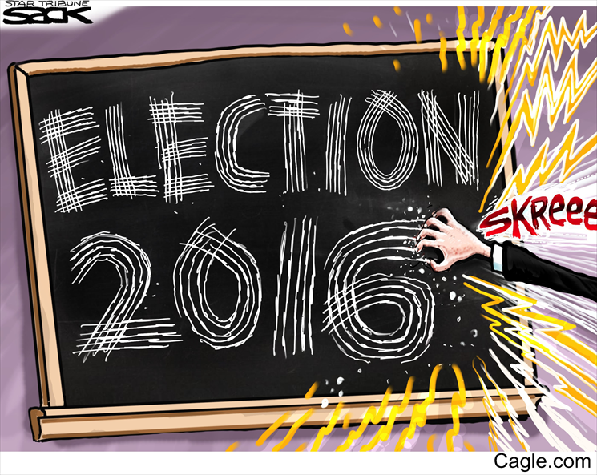
Fingernails on chalkboard? Do you even know what this means? Why is the election being depicted in this way?

Slide 6
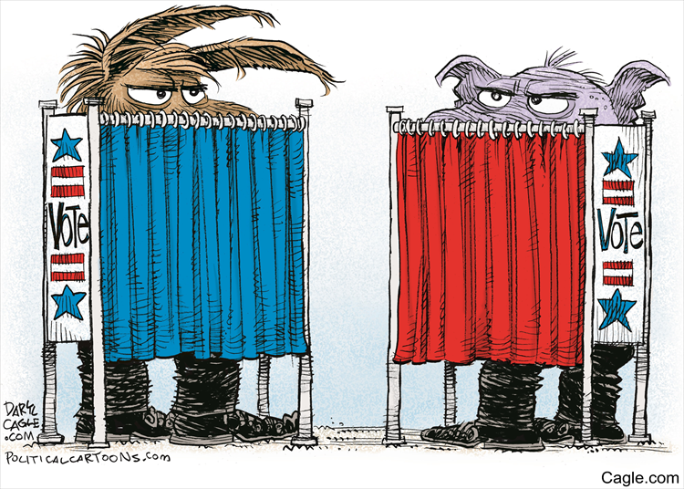
It doesn’t matter which side you’re on…Americans must take the time to vote!

