Slide 1
Current Events
Week of January 9, 2017
Welcome to 2017!! A new year means new
adventures! Think about:
*new places to visit
*a new hobby to pick up
*a new skill to learn
*new books to read
*making new friends
Check out the history behind this holiday
in this short clip.

Slide 2
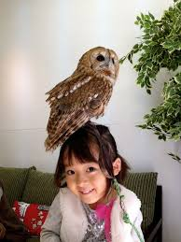
A New Kind of Cafe!!
Sure, you’ve probably been to many different types
of cafes. What about an owl cafe? That’s exactly what
has been springing up all over Japan. It turns out owls
are seen as a sign of good luck in Japan. The cafes
have been especially busy recently with customers
hoping to ensure a prosperous 2017.
Some animal experts are beginning to question the practices of some cafes. While many simply have the birds present, others allow customers to hold and pet the owls. Read more from both sides in this article. Click here to see the inside of one of these controversial cafes.
Ethically, where do you stand on this type of business? Why?

Slide 3
TIME For Kids
Person of the Year
Each December, the readers cast their votes on who
was the most influential person of that year. For 2016,
readers chose actress and singer Zendaya. Among
the reasons for selecting her was her use social media
platforms to fight bullying and promote positive body
image. Read more here to find out about her rise to
fame and see who else got nominations! Be sure to
check out this video to hear how bullying impacted her life.
Who would have gotten your vote for 2016?
How can you make a difference in 2017?

Slide 4
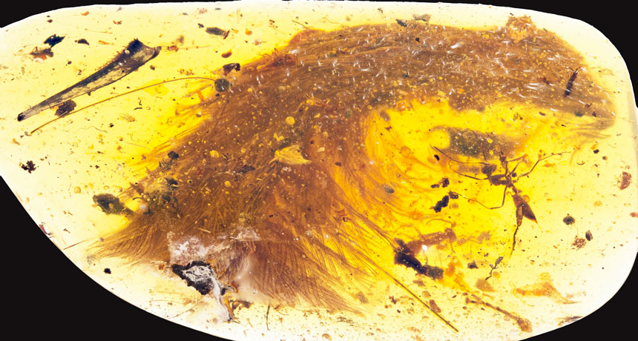
We’re Not Just Talking Your Average Fossil!!
This picture is of a 99 million year
old piece of amber! Scientists
recently discovered it with a tiny
dinosaur tail inside….with the
actual feathers still intact!
Measuring about an inch and a
half long, it is thought to belong to
a coelurosaur. You can read all the
interesting facts in this article.
This video will allow you to take a closer look!

Slide 5
Thoughts?

