Slide 1
Week of December 5, 2016
Current Events
We’re heading into the final month of 2016. What was the most important news story of the year? Why?
If you had to name a Person of the Year who would you chose? Why?
Something extra today...
Start your day off with this amazing use of multi-media.

Slide 2
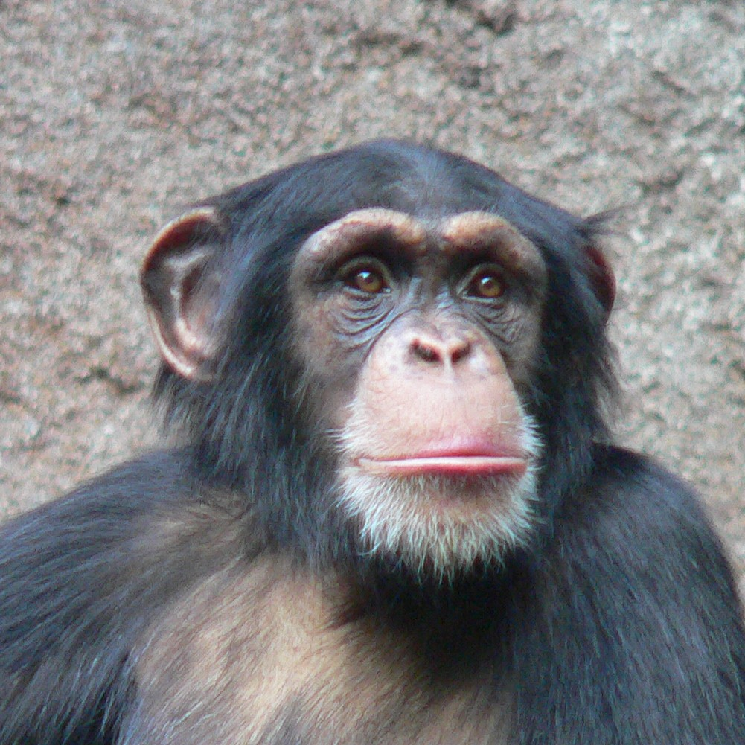
Monkeys Using Tools in the Wild!
Chimpanzees continue to amaze us with their clever, and often human-like, tactics in the wild. While they’re known to use tools to help them gather food, these instruments differ depending on the environment. Now, researchers have spotted them fishing in Bakoun, Guinea, using long branches or twigs as fishing rods to scoop up algae. The researchers set up non-invasive observation methods, including remote camera traps. After noticing ‘conspicuous’ sticks near bodies of water, the researchers also placed these traps along rivers and ponds.Doing this revealed scores of chimpanzees, from all walks of life, fishing for algae in the water.
The footage shows how the chimps plunge a long stick into the water and drag it back toward them after giving it time to collect the algae.Then, they scoop it right off the ‘fishing rod’ and eat it.
What conclusions does the chimp’s human like behavior lead you to? What impact does this story have?
Read more about these amazing animals and watch a video!

Slide 3
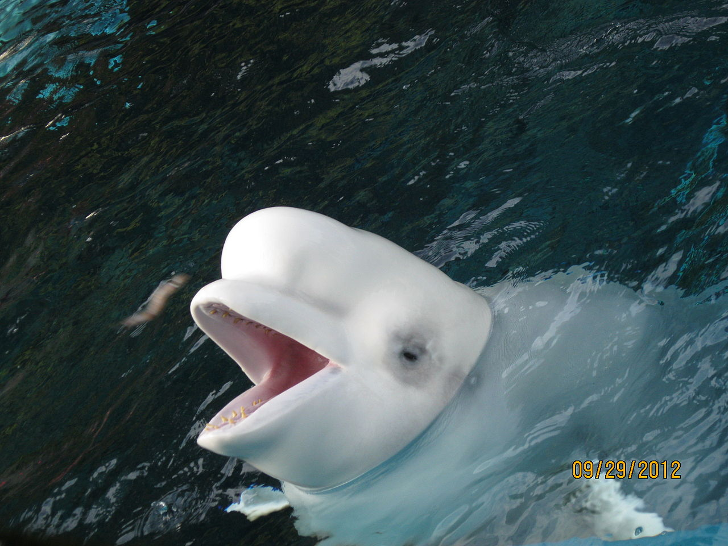
No More Beluga’s
Animal advocates are celebrating what they perceive as a major win for whales. The U.S. has taken action to ensure wild-caught belugas aren’t imported into the U.S. and placed in tanks for the rest of their lives.
The fate of the belugas in question, who live in Russia’s Sea of Okhotsk, stirred controversy back in 2012 when the Georgia Aquarium filed a permit seeking to bring 18 of them here for public display .
Had the Georgia Aquarium been successful, they would have been imported and split up between the Georgia Aquarium, SeaWorld parks in Florida, and other aquariums under breeding and loan agreements. The aquarium would also have marked the first time in 20 years that the U.S. allowed anyone to bring in wild caught cetaceans here specifically for public display .
The National Marine Fisheries Service (NMFS) denied the permit request for multiple reasons, and despite repeated attempts to challenge the decision over the past few years, the Georgia Aquarium has remained unsuccessful. This past June, it finally announced it would be giving up.
What are the pros and cons to keeping animals in capivity? Hear the news report.
Find out how the movie Finding Dory impacted this industry

Slide 4
Do You Have A Smart Mother?
I hope so!
New research says people are born with conditioned genes that work differently depending on if they're from your mother or father — and when it comes to your intelligence, those genes are from mother dearest. Even though people used to believe your smarts were from your father and mother, that's not the case. You see, intelligence genes are located on chromosome X and since women carry two, that means children are twice as likely to get their intelligence from mom. And even if your father passes off a few of his intelligence genes to you, chances are they won't have an impact on your brain since they only work if they come from your mother. Want even more proof? The Medical Research Council did a study on mothers back in 1994 and interviewed 12,686 young people between the ages of 14 and 22. Their questions focused on the children's IQ, race, education and socio-economic status. The best predictor of intelligence? The IQ of their mother.
What is your personal response to this research study? How might a research prove or disprove this study?
What a debatable subject!
http://www.today.com/video/you-can-thank-your-mom-for-how-smart-you-are-study-says-765798979939

Slide 6
Thoughts?

