Slide 1
Fashion through the Ages
Why are you wearing that???

Slide 2
Lesson Questions
How did people dress before 1900?
What is the Victorian Age?
What is the Edwardian Age?
Why does fashion change?
How did people dress in the Roaring Twenties?
Are any of the 1920s fashions still in style?
What does fashion tell us about a time period?

Slide 3
How did people dress before 1900?

Slide 4
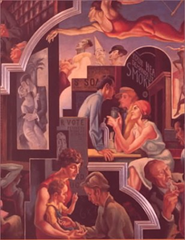
Montezuma handed over an entire kingdom to Cortez because the conquistador wore a small black hat that Montezuma had dreamt about: the very hat Quetzalcoatl would be wearing when he came to reclaim the Aztec throne.
The sixteenth-century meeting between Francis I and Henry VIII on the Field of the Cloth of Gold saw each ruler hoping to overwhelm the other through the sheer magnificence of his dress.

Slide 5
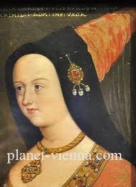
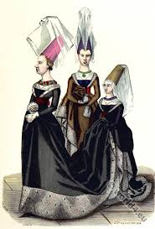
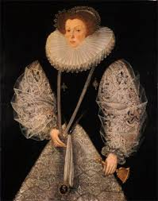
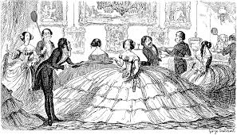
Fifteenth-century doorways were redesigned to accommodate toppling hats, the long-handled spoon was invented so people could eat over their ruffs, and the Victorian woman caged in crinoline redefined the century's sense of personal space (only three women wearing crinolines could possible stand in a room at the same time).

Slide 6
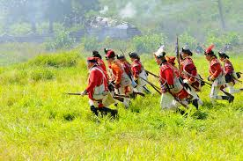
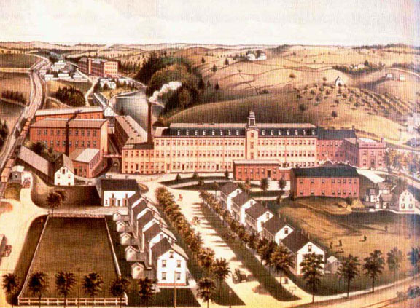
you could say that the British lost the war and the Colonies because the Red Coats stood out like a sore thumb.
The production of fashion and textiles is directly related to the rise of guilds and towns in the Middle Ages and sweatshops in the twentieth century.

Slide 7
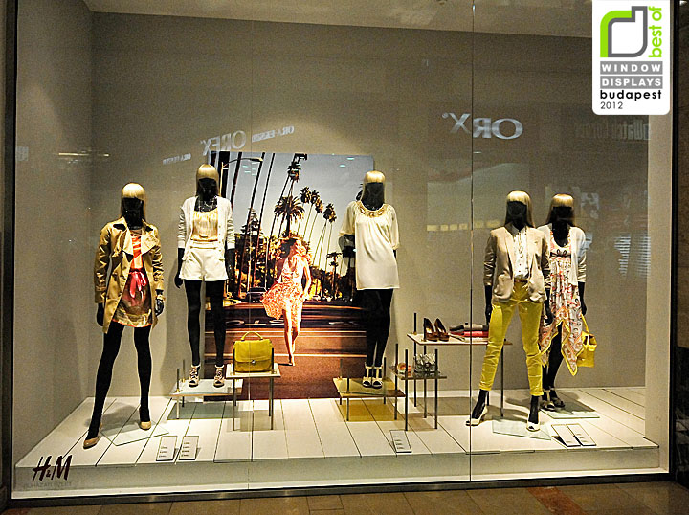
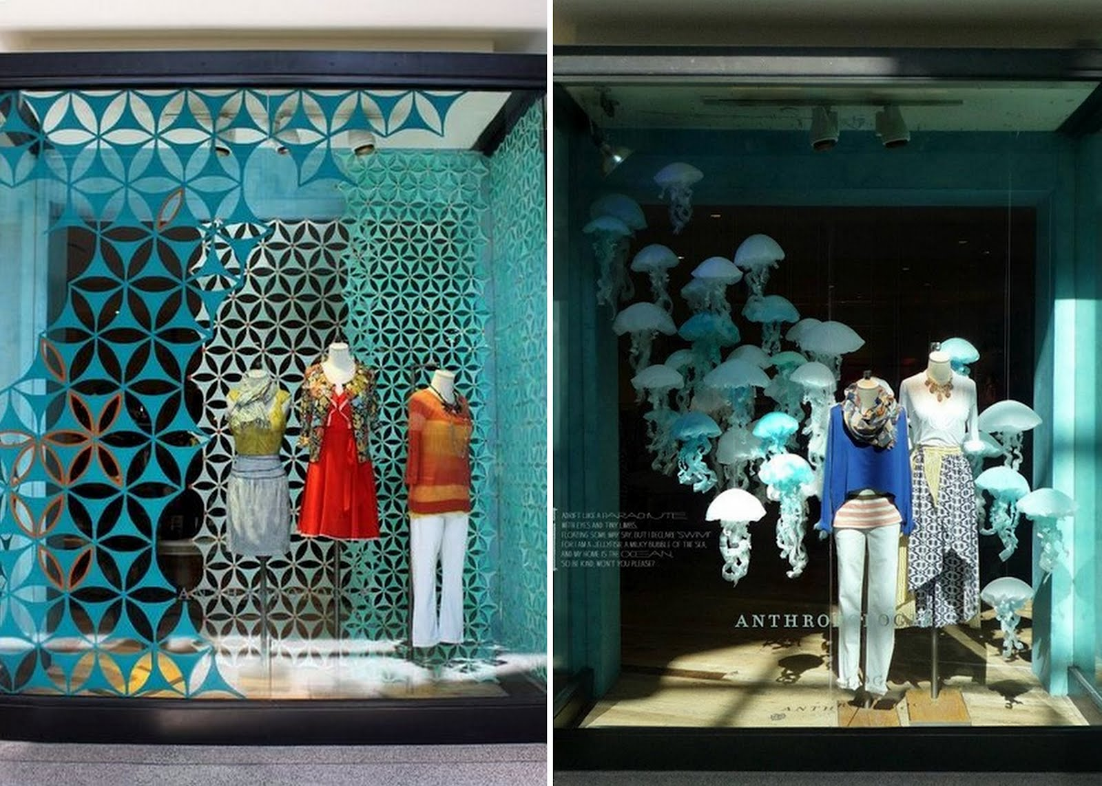
Fashion has never been merely a window dressing. Fashion affects its era as much as it is affected by the times--what people wear has impact on their customs, economics, politics, and physical environment.
We look. We see. We hear volumes about customs, politics, ego, status, and even the local weather based upon what people are wearing.

Slide 8
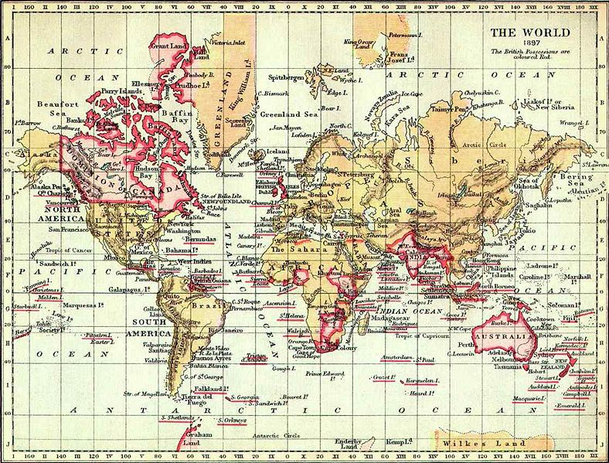
Power and Empire
•Richest nation
(first industrialized nation)
•Most powerful nation –unchallenged military supremacy –empire covers ¼ of earth’s surface
•18 major territories added including India, Canada, Australia, New Zealand, most of East Africa and the Caribbean

Slide 9
What is the Victorian Era?

Slide 10
Queen Victoria
Born on 24 May 1819.
On 10th June 1837, following the death of her uncle, William IV, she became queen at the age of eighteen.
Queen Victoria ruled England from 1837-1901.
Before this time, men were the focus of fashion, but with a queen in power, women surged to the forefront. The role of a wife became to show of her husbands status and wealth to the public, with the husband himself receding into the background.
Queen Victoria died aged 80 on 22 January 1901 and a new age - the Edwardian - began.

Slide 11
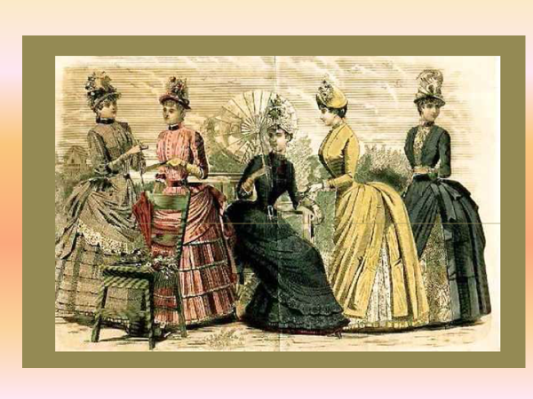
Flowers and Bows for Young Women
Young women of the Victorian era were expected to cover themselves completely and accentuate only their waists.
Corsets, petticoats, bustles and hoops all made women's attire cumbersome.
Hats and bonnets were decorated lavishly to match dresses and overcoats.
Eligible young women wore clothing that was decorated with flowers and bows, in hopes that the added flair would attract potential husbands.

Slide 12
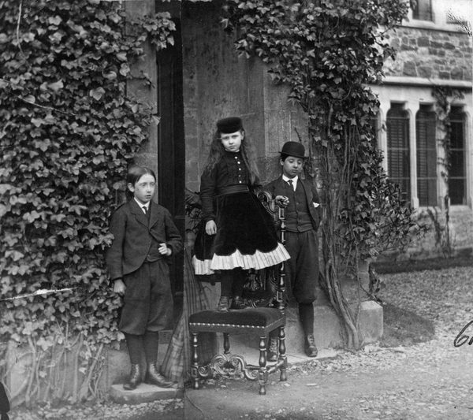
The era was one of increased pressure to live and dress "properly." Standards of decorum were required of all classes. Like their parents, children and young adults were expected to dress and act appropriately at all times.

Slide 13
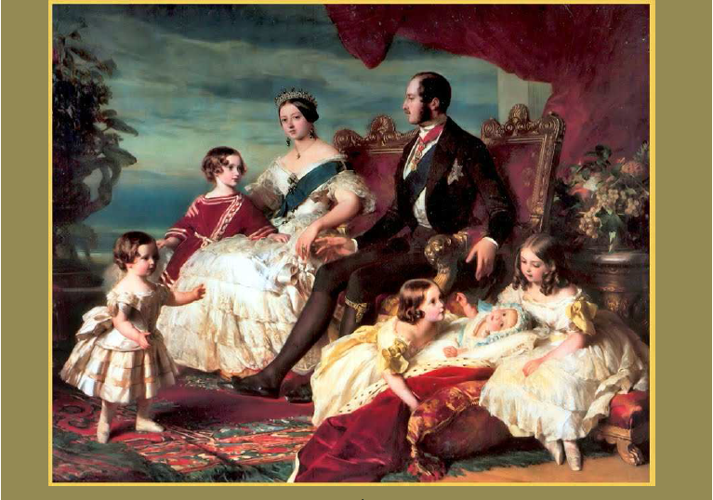
Slacks and Shorts for Young Men
For young men, the Victorian era brought with it some less restrictive styles.
Although stockings still covered their legs, tight pants were replaced by straight legs.
Straight slacks and shorted knickers allowed young boys to play sports and cycle easily.
Loose frock coats, casual plaids and fitted caps were common for daytime wear, although fitted dress coats and tails remained the standard for evening wear.

Slide 14
What is the Edwardian Age?

Slide 15
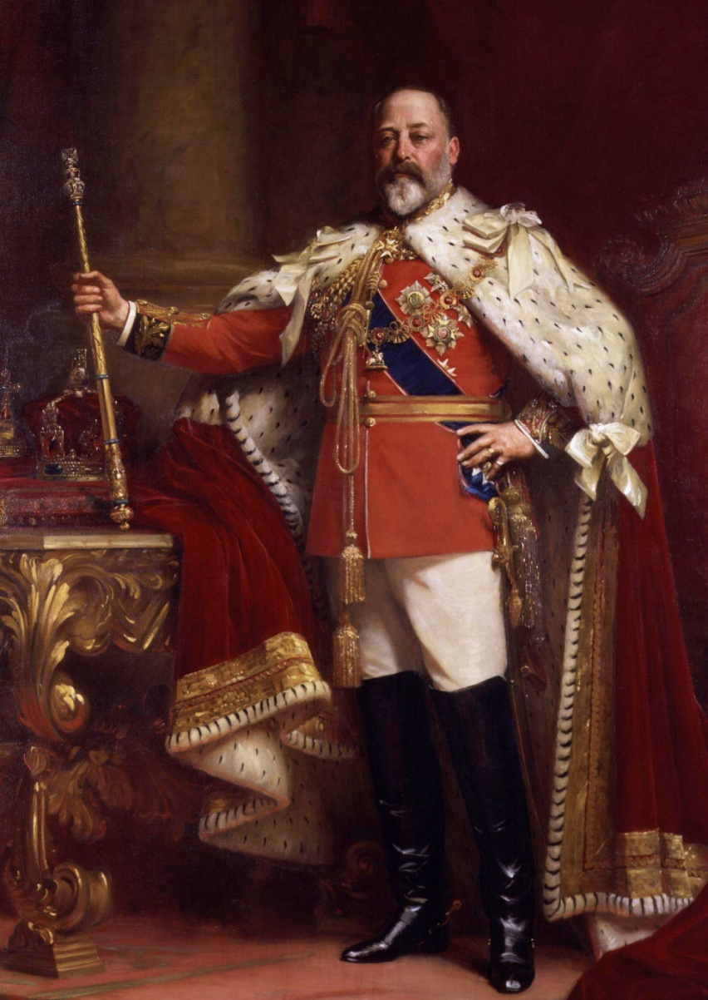
The Edwardian era or Edwardian period is the period covering the reign of King Edward VII, 1901 to 1910, and is sometimes extended beyond Edward's death to include the four years leading up to World War I. The death of Queen Victoria in January 1901 marked the end of the Victorian era.

Slide 16
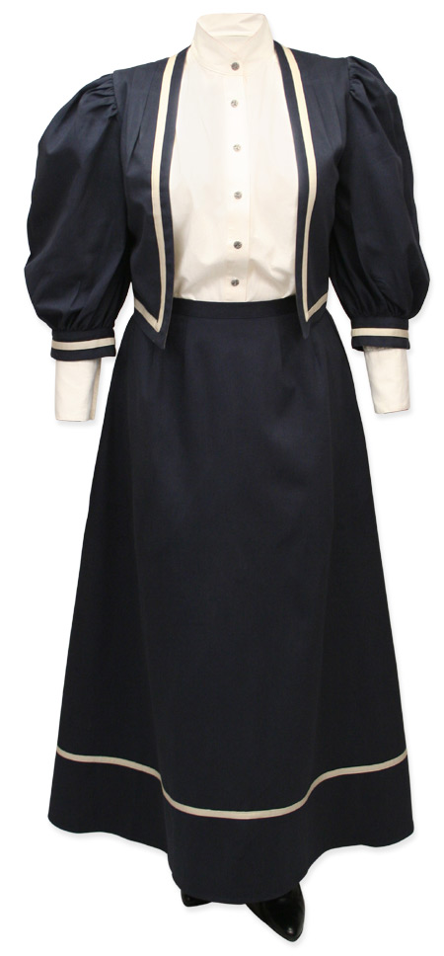
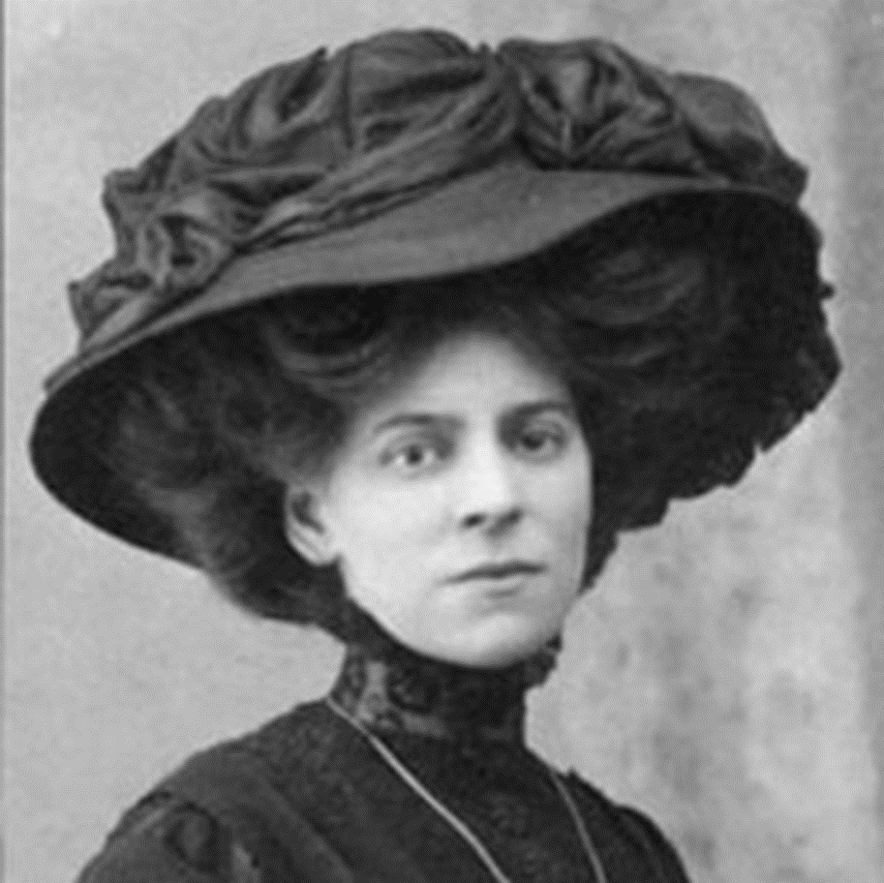
Edwardian clothing allowed women to stray away from the constricting and unhealthy Victorian corset. This style offered more comfortable, versatile clothes that let women remain active.
More so than in the Victorian era, it was common to see Edwardian women sporting blouses and skirts instead of full ensembles.
Women also commonly wore natural-waist dresses that didn't require hoops or as many petticoats as traditional Victorian clothes.
In fact, some were completely straight sheath dresses that required few (if any) petticoats. This was incredibly important to note as women's fashion continued to change and skirts eventually became shorter in the 1920s

Slide 18
How did people dress in the Roaring Twenties?
Notes:
1920s fashion reflects society's rapid movement and change.
No longer were women willing to trade their mobility for the old stodgy customs of the Victorian era. Old-fashioned torture devices like the corset and the crinoline no longer served a purpose for young women who wanted to dance, go to work, hop into cars, and walk around town.

Slide 19
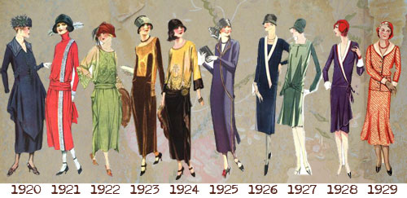
Notes:
The arrival of the Jazz Age from the city of New Orleans and the music of Louis Armstrong became the anthem for the flapper, black or white and especially in the USA where alcohol was prohibited throughout the 1920’s and the term the ‘Roaring Twenties’ can be said to have been aptly applied. The invention of film and the rising influence of Hollywood along with an increase in fashion marketing; the merging of the Arts Decoratifs and new Modernist movements; the cultural impact of a world war which reduced the grip of the class system on both sides of the Atlantic, encouraging different classes and races to mingle and share their sense of freedom in the fight for suffrage; and the rise of consumerism which promoted the ideals of ‘fulfilment and freedom’.

Slide 20
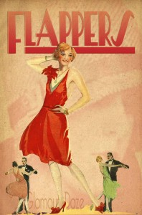
The Flapper
By Dorothy Parker
The Playful flapper here we see,
The fairest of the fair.
She’s not what Grandma used to be, —
You might say, au contraire.
Her girlish ways may make a stir,
Her manners cause a scene,
But there is no more harm in her
Than in a submarine.

Slide 22
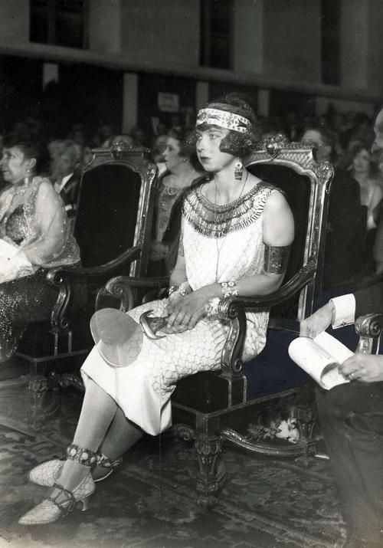
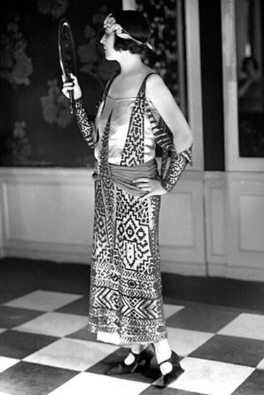
Tut Tut!

Slide 24
Hat Parade

Slide 26
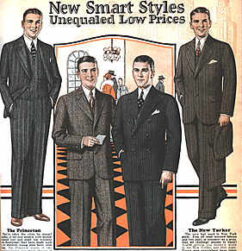
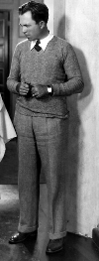
Men's Wear
Notes:
Men's fashion in the 1920s changed as well, stars like Rudolph Valentino, Douglas Fairbanks, Al Jolson and Chalie Chaplin redefined what men should look like, and what they should wear.
The growing business class promoted growth of the major cities throughout the country and men began dressing in tailored suits rather than the overalls of the country.

Slide 27
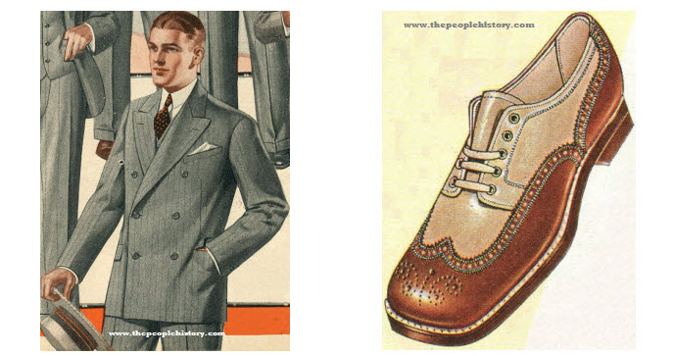

Slide 28
Fun with Fashion!

Slide 29
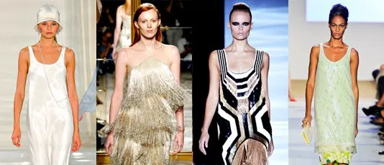
Are any of the 1920s fashions still in style?
Notes:
straight-up-and-down flapper dress: features the relaxed silhouette and a drop-waist, the 20s’ trademark frock makes you look striking without being too showy
silk: look for silk dresses in pastels and luxurious silk pants. They all bring the ultra-feminine vibe especially when gearing up for a night out
lavish details: ostrich feathers (think about feather boas!), fringe detailing, beaded embellishments and allover sequins give a distinctly 1920s sensibility
pleats: straight-cut skirt and a dress are next on your shopping list!
strappy shoes: strappy sandals or T-strap pumps complement every glamorous look
accessories: long swingy necklaces, drop earrings, pearl necklaces and metallic accessories (in general) enhance the glamour

Slide 30
Your turn!
It’s time to create your own paper doll!
1. With a partner, trace a body. Draw a face and decide on hair.
Decide on an outfit. Cut it out of paper and “dress” your paper doll.
Choose accessories such as beads, feathers, and buttons to glamorize your doll.
Don’t forget the feet! Make sure your outfit includes shoes!

