Slide 1
Week ofJanuary 30, 2017
Current Events
On this day in history:
January 30, 1920-Japan’s Mazda founded
January 31, 1851-Condensed milk invented
February 1, 1884-Oxford Dictionary debuted
February 2,1887-Groundhog Day begun
February 3, 1876-Albert Spalding started sporting goods company
*Founded, invented, started, debuted, begun… What does these words have in common?

Slide 2
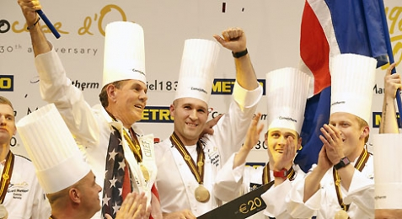
U.S. Team Wins International Cooking Competition
Edging out 23 other countries, a team of American chefs won the Bocuse d’Or culinary competition last week. This competition, somewhat like the Olympics for professional chefs, occurs every two years. The United States team took home the gold medal for the first time in the 30 years the contest has been in existence. The team had five-and-a-half hours to create a meat dish and a vegan meal. They made their version of chicken and crawfish, which included morel mushroom sausage, a wine glaze, and lobster sauce. The vegan dish consisted of asparagus with cremini mushrooms and potatoes. It also included a green-almond custard and a Bordelaise sauce.
What other types of competitions can be compared to the Olympics? Are sports competitions more important than cooking or academic competitions?

Slide 3
Debate!
Cupcakes, cookies, and fudge! Oh, my!
When you think of these sweet treats, do you think of earning money? Many schools across the nation have held bake sales in order to raise money for activities and supplies. Field trips, sports teams, and art programs are examples of some of the beneficiaries. However, because U.S. Department of Agriculture guidelines proposed in 2010 and recently finalized, many states have banned the selling of sugary treats at fundraisers during the school day.
“Gone are the days of junk food, snack cakes, chips, and full calorie sodas at school,” Colin Schwartz told TFK. He is the Senior Nutrition Policy Associate at the Center for Science in the Public Interest. “We hope to prevent childhood obesity and instill healthier eating habits in kids for a lifetime,” he adds (“News” 2017).
Should school bake sales be banned? Cast your vote!
Source: "News." Debate! | TIME For Kids. Time, Inc., 27 Jan. 2017. Web. 27 Jan. 2017.

Slide 4
China Welcomes the Year of the Rooster!
On Saturday, January 28, Chinese communities around the world began a two-week celebration to usher in the Chinese New Year.
Also called the Spring Festival, the holiday whose dates are determined by the lunar calendar, is the grandest and most famous of all Chinese festivals. To enable residents to be with their families and friends, most employers in China give their workers at least seven days of vacation. Schools and universities are closed for an entire month.
How does this festival compare to America’s celebration of the new year?
Explore Chinese Horoscopes here.
Find out more about China and the Chinese New Year with this video.
Read more about this exciting celebration here.

Slide 5
Political
cartoon
What is the viewpoint of this cartoonist? Have you ever repeated something as fact because you “saw it on the Internet?” What are the dangers of fake news?

