Slide 1
Week of Sept. 26, 2016
Current Events Wk #8
What does this quote by Mark Twain mean? Do you agree or disagree? How else could you become informed?

Slide 2
Type of news item: International, National, State, Local or Business
As our National Park System celebrates its 100th year, some of us are wondering, “What is it like to be a national park ranger?”
What is it like to be a park ranger at one of our nation’s “national treasures”? Think about what attributes it must require to take on this important job and then read the article and watch the videos to find out what the data and the rangers have to say.
Here are some of the numbers to consider:
3,861: the number of park rangers who work for the National Park Service
280 million: the average number of visitors to national parks each year
Article about what it is like to be a park ranger

Slide 3
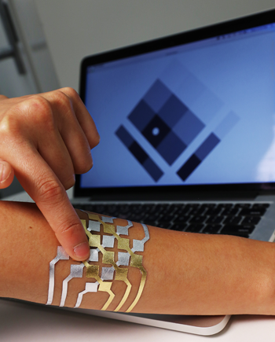
Tattoos to Control Your Technology? Coming Your Way!
Why do people get tattoos? We might answer that people get a tattoo to make an artistic statement, to express a passion, to be cool, etc.. How about a tattoo to control technology? That’s right! Cindy Kao, a computer scientist and artist from MIT, and two other computer scientists, have worked together to create temporary tattoos called DuoSkin that are fashionable, affordable, and functional. DuoSkin is made from a skin-safe material called imitation gold leaf that conducts electricity. When applied to the skin, DuoSkin becomes a control for your tech devices. Watch the video to see Cindy Kao describe this futuristic tattoo. Do you think that such customizable fashion accessories could one day control the devices used for everything from medicine to communications and entertainment? What would be some of the advantages and disadvantages for this invention? Would you change it in any way?
Article about the invention of DuoSkin
Watch this video for more information!

Slide 4
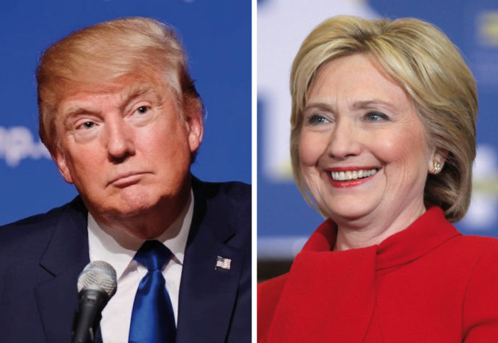
Type of news item: International, National, State, Local or Business
Trump-Clinton debate expected to shatter records
The first debate between presidential candidates Donald Trump and Hilary Clinton will take place this week. Read the article and see if you can answer these questions: https://www.studentnewsdaily.com/daily-news-article/trump-clinton-debate-expected-to-shatter-records/
1. a) When is the first presidential debate? (date, time, place, how/where to watch)
b) How many viewers are possible, according to experts interviewed by The Hill?
2. Why would such a large number of viewers be so significant? (see para. 2-3)
3. How would 100 million compare to the final episode of MASH? to the 2016 Super Bowl? the 2015 Super Bowl halftime show?
4. Why does the reporter think that there will be a huge audience for the first debate between Clinton and Trump?

Slide 5
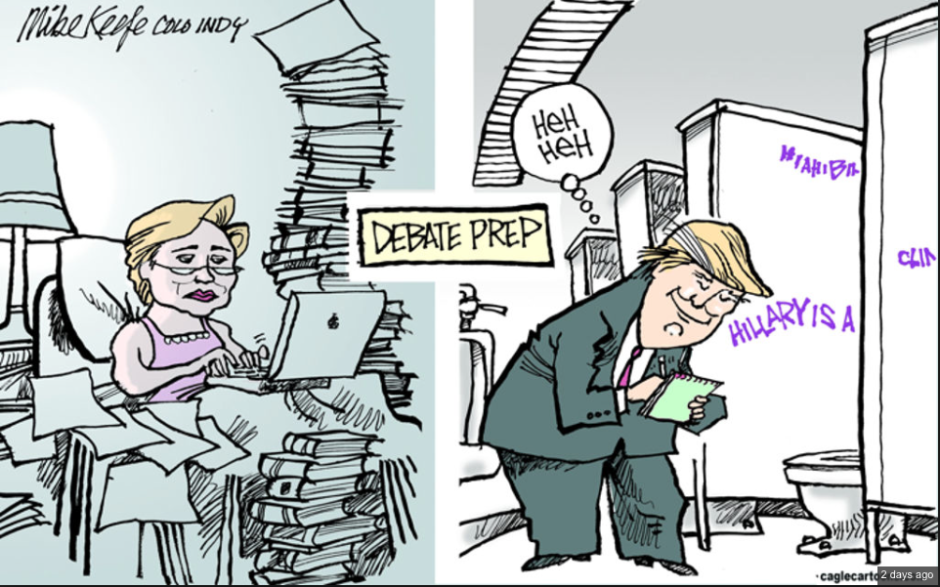
Thoughts?

Slide 6
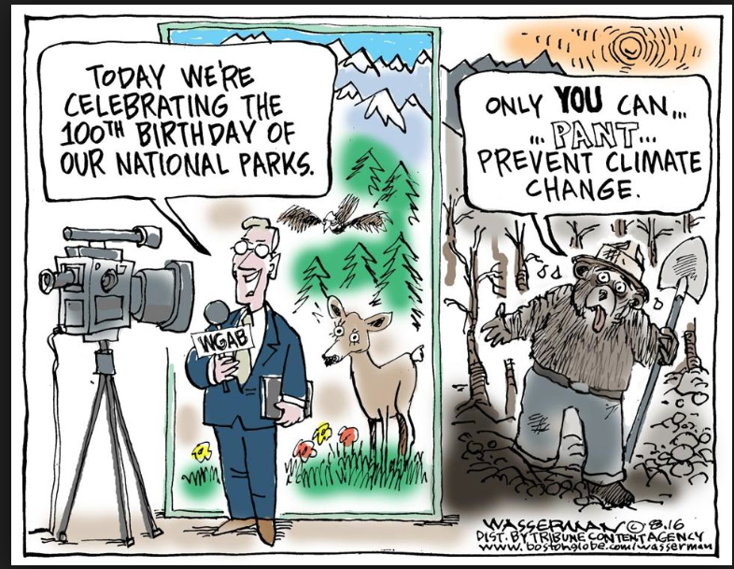
Thoughts?

