Slide 1
Week of October 7, 2016
Current Events Wk #10
October 11, 1982--Space shuttle Challenger astronaut, Kathryn Sullivan, became the first American woman to walk in space.
October 12, 1492--Columbus landed in present-day Bahamas.
October 13, 1903--Boston defeated Pittsburgh in the first World Series.
October 14, 1964--Martin Luther King, Jr., was awarded the Nobel Peace Prize for his work in civil rights.

Slide 2
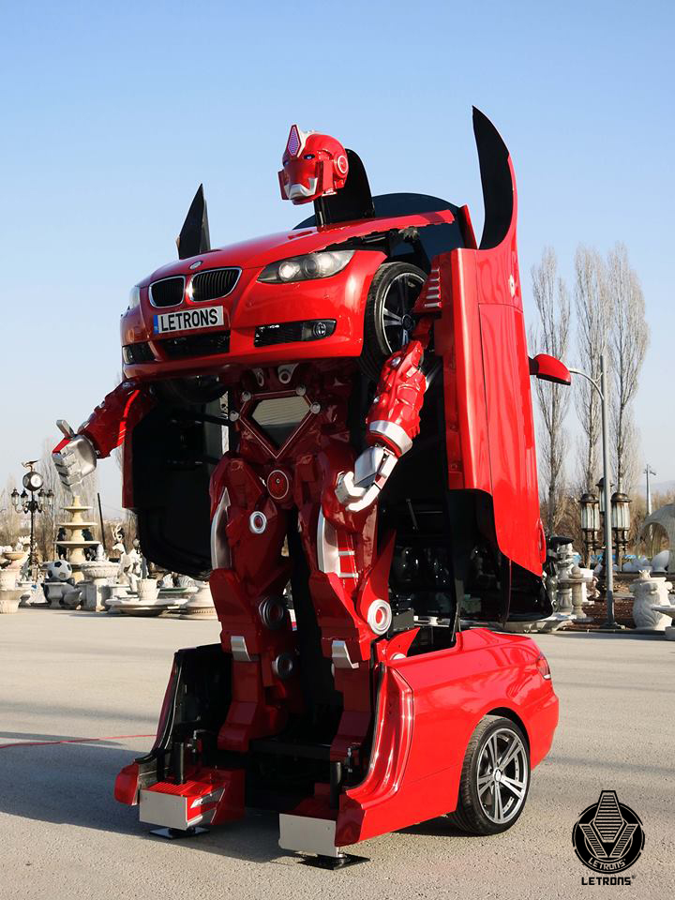
Type of news item: International, National, State, Local or Business
Real-life transformers?
You may have seen Transformers. They are toys that have parts which can be shifted to change from a vehicle to a robot. A Turkish technology company has developed a prototype of a car that can be turned into a robot. Even though the car can’t be driven in traffic, and the robot cannot walk, the company believes they can make improvements in the future. Plus, people are already lining up to buy this innovative machine.
Would you like a life-sized toy? What futuristic or unique project would you like to undertake? Why?

Slide 3
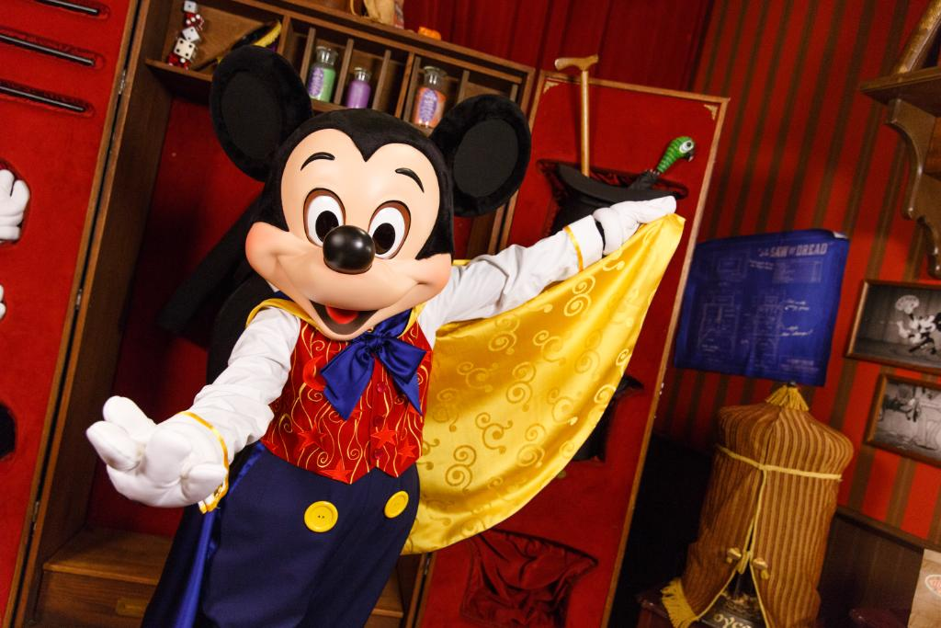
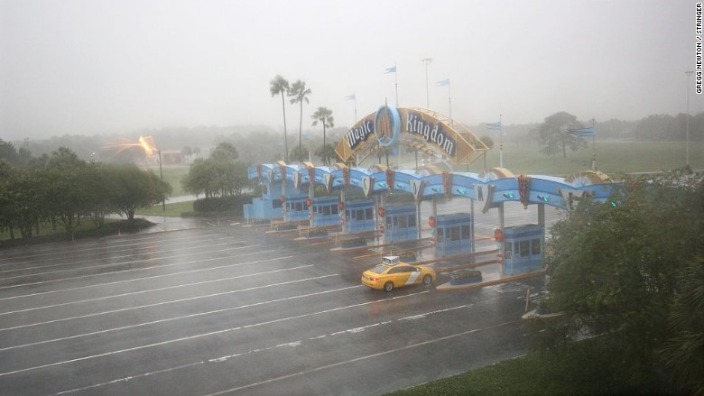
Type of news item: International, National, State, Local or Business
Mickey Mouse Takes a Day Off
Due to winds over 100 miles per hour caused by Hurricane Matthey, Walt Disney World resort in Orlando, Florida made the decision to close all of its parks, golf courses, and ESPN Wide World of Sports complex. This is only the fourth time ever Walt Disney World has closed its gates. Each time has been because of a hurricane.
What impact will closing these parks have on Disney financially? If you were in charge of the parks, would you have stayed opened?

Slide 4
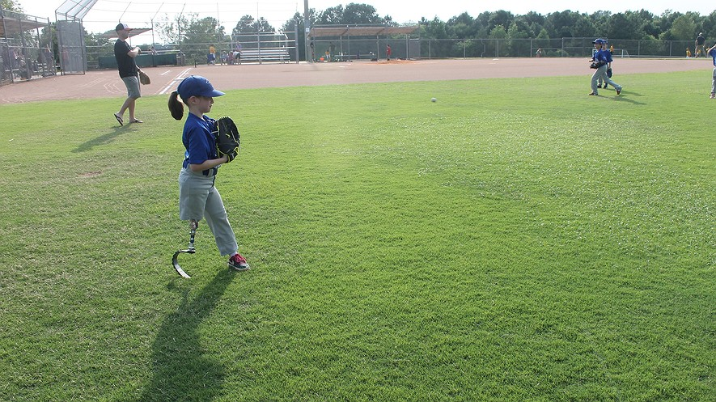
Type of news item: International, National, State, Local or Business
Do you like to play sports? Rosie McRackan, a 6 year old from North Carolina loves to play T-ball. What makes her story special is that Rosie wears a man-made leg called a prosthetic so that she can run. Rosie was born without her lower left arm and her right leg. However, she has a special leg made for running and an arm controlled by her own muscles’ signals. “Everyone wants to belong,” said Judy Newsome. She runs a program called Inclusive Services.
This program gives kids like Rosie a chance to play like everyone else. Newsome says that’s what matters.
Read more about Rosie and this program here.

Slide 5
Thoughts?

