Slide 1
Consumerism
Consumerism In The 1920s

Slide 2
What does it mean to “consume?
The want to consume is nothing new. It is has been around forever.
People need to consume resources to survive.
However, consumption has evolved as people have found ways to help make their lives simpler and/or to use their resources more efficiently.
The rise of mass consumerism was an incredibly significant series of events that drastically altered the way society functions today.

Slide 3
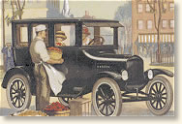
Consumerism
the culture surrounding the buying and selling of products
Ford Ad - 1924 Tudor Sedan $590, Sedan $685, Coupe $525

Slide 4
Consumerism
By 1919, the USA was the most powerful economy in the world. It had probably been that powerful before the war, but by 1919 it was clear. While the European counties struggled to get their economies going again and tried to repay their debts, the USA simply got richer.

Slide 5
Consumerism
The USA also had vast supplies of raw materials that had hardly been touched. Many Americans were immigrants who had come to the USA looking for a land of opportunity. They were prepared to work hard and take chances. New industries developed, especially production of electrical goods and man-made fibers. These all benefited from the introduction of the production line. The German chemical industry was held back by the war; the US took the lead, making dyes, fertilizers and plastics. This gave the USA an extra advantage in these new industries.

Slide 6
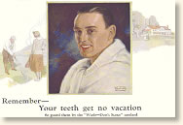
Consumerism
Consumerism came into its own throughout the 1920s as a result of
mass production
new products on the market
improved advertising techniques
Colgate Toothpaste Ad - 1924 $.25 for the large tube

Slide 7
Consumerism
There was in effect a second industrial revolution, in consumer goods, like radios, cars, fridges, telephones and vacuum cleaners. These goods were not new but they had previously been available only to the rich. Now they were sold, in millions, to a mass market. The great benefit was that these products all made life easier. Less time had to be spent on routine household work, so people had more time for leisure.

Slide 8
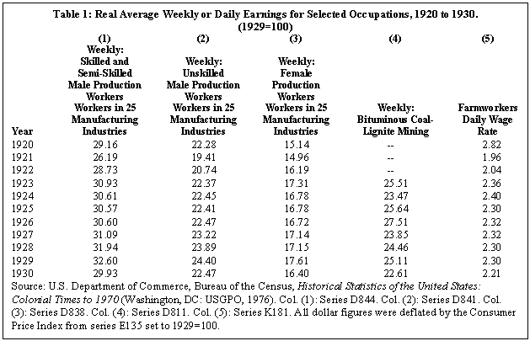

Slide 9
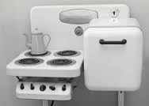
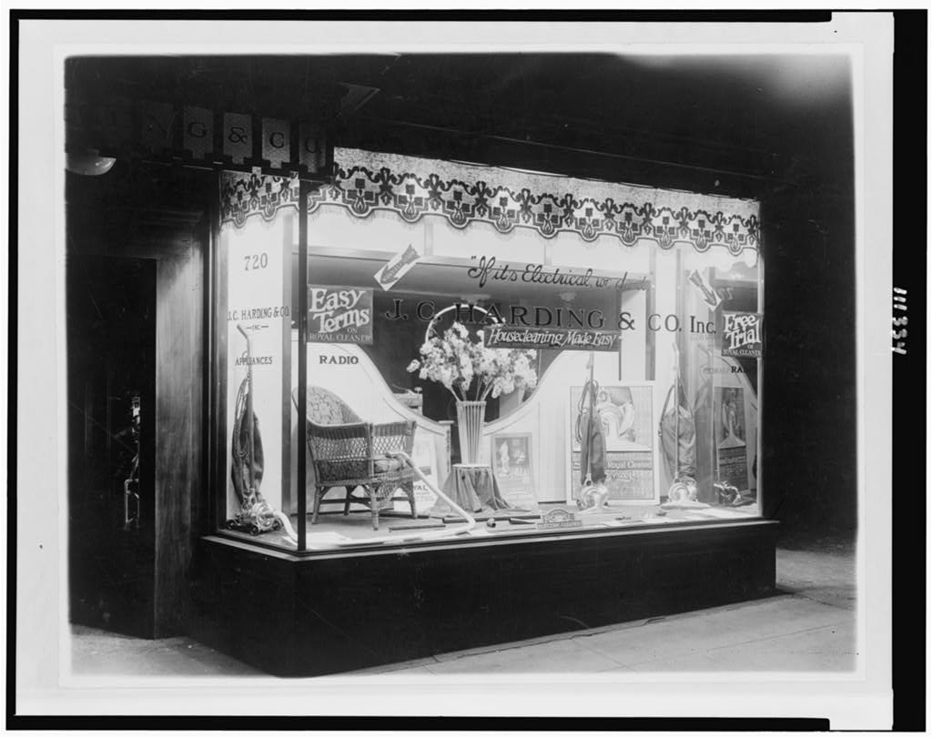
Consumerism
With more leisure time available and money to spend, Americans were eager to own the latest items.
Advertisers used this to their advantage, often stressing luxury and convenience.
Every home was a market for electrical appliances of all kinds—refrigerators—washing machines—vacuum cleaners—

Slide 10
Millionaires in America
Most Americans believed that they deserved success. For example; a nice house, a good job, plenty to eat, and many consumer goods. The act of 'consuming' was seen as very American, and this belief that spending and consuming was 'American', had a huge impact on powering economic growth in the 1920s.
The growth in number of millionaires is shown in Tax Reports by the Treasury Department, who reported that there were 21 individuals with an annual income of over one million dollars in 1921, 75 in 1924, and 207 in 1926. There were an estimated fifteen thousand U.S. millionaires in 1927, and at least one billionaire (cumulative net worth), nearly four thousand of these living in New York, including three thousand living on or near Park Avenue.

Slide 11
Consumerism
New methods of buying and selling and advertising were developed. Chain stores, buying on time (credit), mail order, and travelling salesmen meant that it became much easier to buy and pay for new purchases.

Slide 12
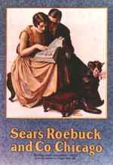
Consumerism
Sears, Roebuck & Co., a company founded in 1893, regularly issued a mail-order catalog. By the 1920s, the catalog, nicknamed “the consumer's bible,” had become enormously popular.
It completely revolutionized how people purchased items. The catalog contained literally hundreds of pages featuring products like sewing machines, bicycles, clothing, radios, and just about everything else imaginable.

Slide 13
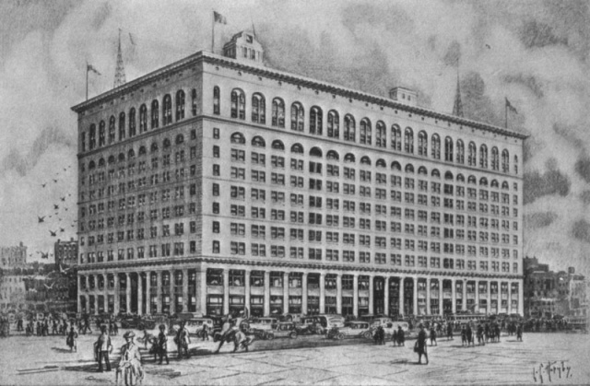
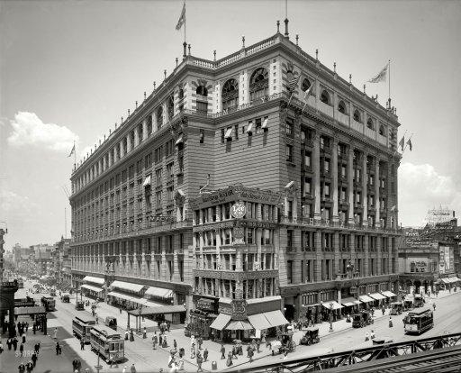
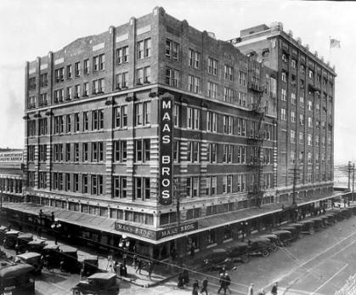
Consumerism
Large department stores in rapidly-growing cities, such as Wanamaker’s in Philadelphia and New York, Macy’s in New York, and Marshall Field’s in Chicago, also pioneered new advertising styles.
Wanamaker’s in Philadelphia
Maas Bros. store circa 1922
Macy’s in New York

Slide 14
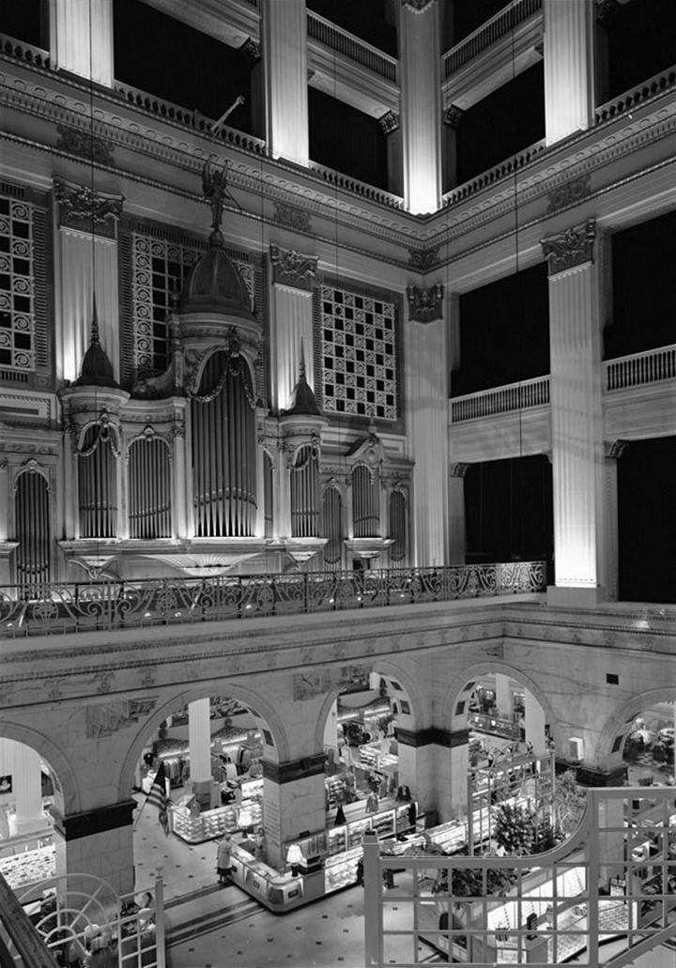
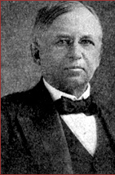
Before Wanamaker invented the price tag, most buying was done by haggling. A devout Christian, he believed that if everyone was equal before God, then everyone should be equal before price.

Slide 15
Calvin Coolidge, President of the USA 1923-29. Coolidge said,
Advertising makes new thoughts, new desires, new actions. It is the most powerful influence in adapting and changing the habits and way of life, affecting what we eat, what we wear and the work and play of a whole nation.

Slide 16
Consumerism
Radio—is it “a blessing or a curse?”
It is “virtually useless,”
“just another disintegrating toy.”
It is “a Tremendous Contribution,”
“the only means of instantaneous communication
yet devised by man.”
Radio “will elect the next president”;
its listeners comprise “an organization that in days
to come will be the most powerful in the world.”
However you judged radio as it grew from a “helpless youngster” into a “husky adolescence” in the 1920s, one thing was clear—“There it is, up in the air, absolutely free, waiting for you to pull it down with the aid of electricity.”

Slide 17
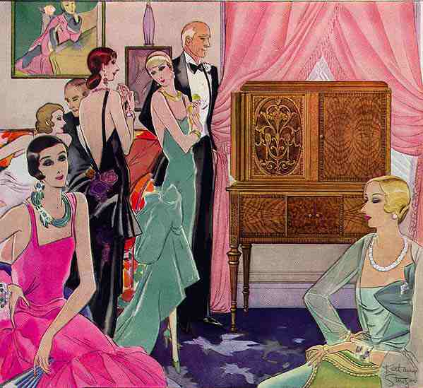

Slide 18
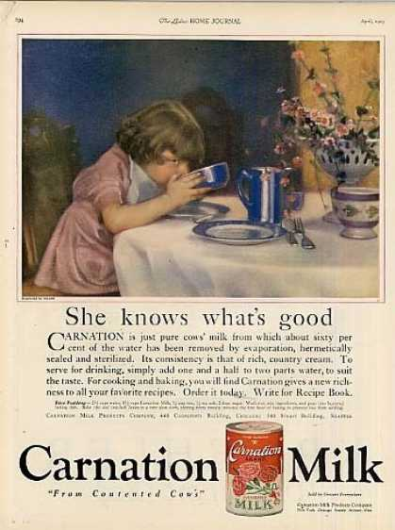
print advertisements
Carnation Milk Ad (1923)

Slide 21
Gruen Watches Ad (1924)

Slide 22
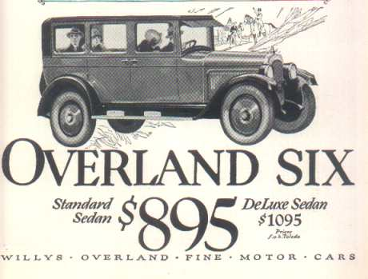
Consumerism
WILLYS OVERLAND (from 1925 ad)
Radio Ads

Slide 24
Your Assignment Choices
1. Complete the “Shopping by Mail” activity
OR
2. Write a paragraph (at least) titled, “Consumerism is…”
Explain consumerism and how the lifestyles of Americans were significantly affected by the availability of labor saving products, luxury items and the emergence of mass advertising campaigns and consumerism.
You can use the QR code or printed article for information

