Slide 1
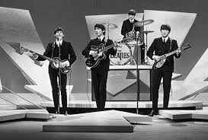
Week of February 6, 2017
Current Events
This Week in History:
2/6/1952: Princess Elizabeth becomes queen of England.
2/7/1968: Forensic evidence solves a crime.
2/9/1964: British rock-and-roll band, the Beatles, make their first appearance on the Ed Sullivan Show, a popular television variety show.
2/9/1965: U.S. send first combat troops to South Vietnam.

Slide 2
Two-Billion-Year-Old Water Could Provide Clues to “Alien” Life on Earth and Mars
Upon digging into the earth’s crust, geologists from the University of Toronto discovered water that was at least 2 billion year old!
The water, which was lukewarm, was found flowing in abundance, and it contained several gases, including sulfur. The presence of sulfur is important because some bacteria get energy by transferring hydrogen gas to sulfate. The energy released from these chemical reactions sustain the bacteria.
Earth and Mars have a fairly common geological setting, and scientists think that “as long as the right minerals and water are present below the surface, they can produce the necessary energy source to support the microbes (bacteria)”.
So, although the aliens we see in movies might not have been discovered yet, life in its tiniest form is still pretty exciting!
Why has the ancient water not evaporated over the years? How might the discovery of bacteria on a planet lead to other possibilities?
Source: https://www.dogonews.com/2017/1/29/two-billion-year-old-water-could-provide-clues-to-alien-life-on-earth-and-mars

Slide 3
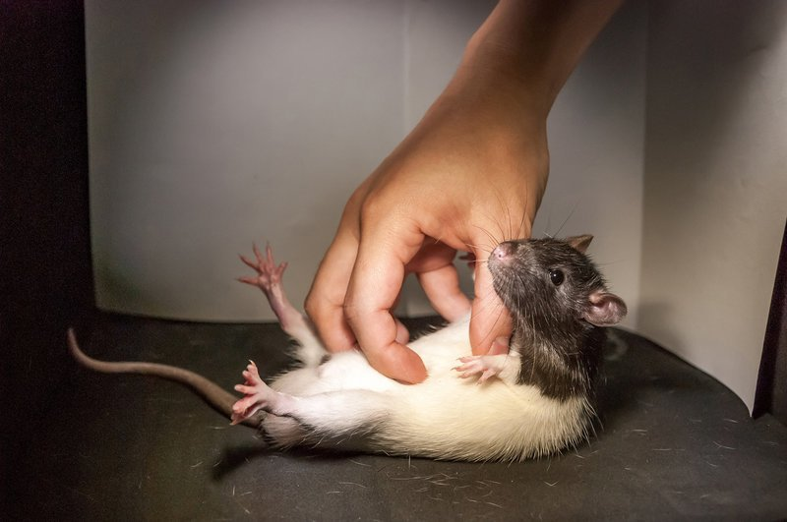
Giggling Rats Provide Insights Into Why Humans Are Ticklish
Why do people laugh and giggle when they are being tickled?
Researchers at Berlin’s Humboldt University are trying to figure out why some body parts, like the underarms and neck, are more susceptible to the sensation of tickling than others and why this type of touch makes humans giggle. Rats were chosen to help with this research because studies show that young rats not only feel the sensation, but also are most ticklish on the belly and feet.
One conclusion researchers found: Tickling is a trick by the brain to encourage social interaction and bonding.
Why is it hard for people to tickle themselves?
Why would the brain want to encourage social interactions and bonding?
Source: https://www.dogonews.com/2017/1/30/giggling-rats-provide-insights-into-why-humans-are-ticklish

Slide 4
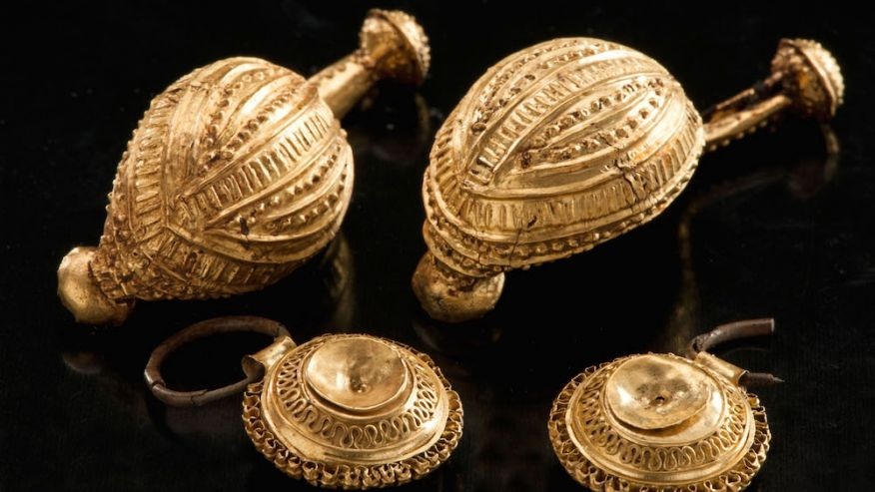
Buried Treasure: Ancient Grave Found Brimming with Jewels
An Iron Age tomb (from 8th century BC) filled with gold, bronze, and amber treasures, as well as piles of fur, belts, and bracelets, was discovered lying undisturbed by the Danube River. The treasures adorned and surrounded the skeleton of a woman, and archaeologists believe that she was an elite member of the Celtic society.
Because ornaments also adorned a horse’s chest, researchers believe the woman was a priestess with a strong connection to horses.
Source: https://goo.gl/oMwhmo

Slide 5
Thoughts?

Slide 6
Thoughts?

Slide 7
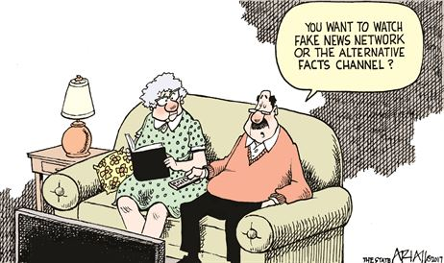
Thoughts?

Slide 8
Thoughts?

