Slide 1
Week of February 13, 2017
Current Events
This Week in History:
Feb. 13, 1945- Towards the end of World War Two, a massive bombing campaign by Allied air forces destroyed the German city of Dresden. Tens of thousands of civilian men, women and children were killed by the bombs and the following fire-storms. It is widely claimed that the bombing had little or no strategic military value.
Feb. 14, 1076- Pope Gregory VII excommunicates Holy Roman Emperor Henry IV (for the 1st time)
Feb. 15, 399- BC Philosopher Socrates is sentenced to death by the city of Athens for corrupting the minds of the youth of the city and for impiety
Feb. 16, 1923- Howard Carter opens the inner burial chamber of the Pharaoh Tutankhamun's tomb and finds the sarcophagus
Feb. 17, 1865- Columbia, South Carolina burns down during American Civil War

Slide 2
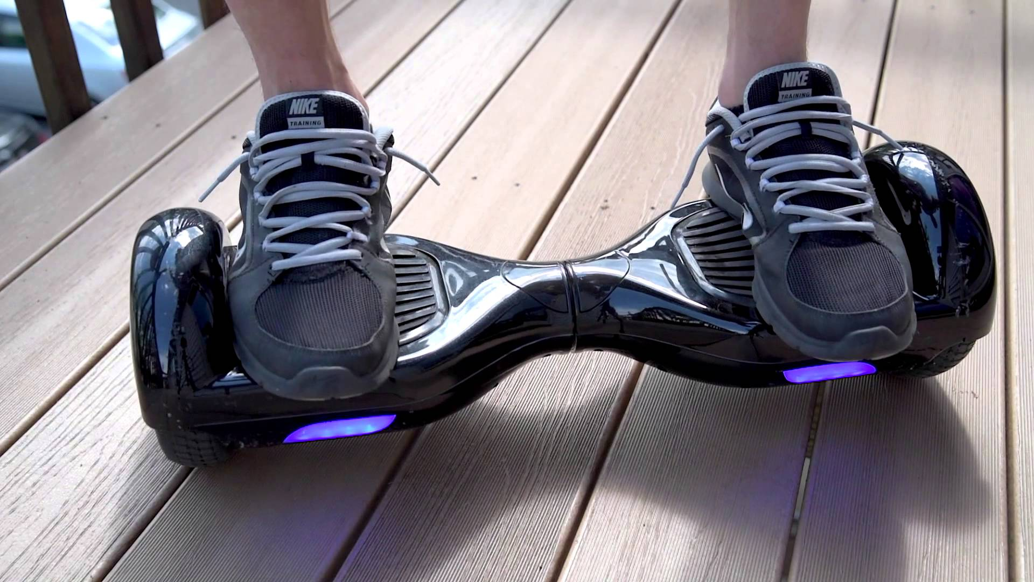
Batteries With Built-In Fire Extinguisher May Be The Answer To Exploding Devices
2016 was a banner year for exploding devices. The trend began when hoverboards randomly began to burst into flames, hurting riders and causing millions of dollars in property damages. Samsung’s S7 Note mobile phone faced similar issues and had to be withdrawn from the market by October. It turns out that all the mishaps were the result of malfunctioning lithium-ion batteries used to power the devices.
Experts assert the batteries are safe for the most part. They only have the potential to catch fire if they are charged too quickly and generate excess heat or have a manufacturing error that creates a short circuit.
On January 13, a team of Stanford researchers announced that they had devised a way to stop the chemical reaction that causes Li-ion batteries to combust by using using a chemical compound as a fire extinguisher.
Source: https://www.dogonews.com/2017/2/11/batteries-with-built-in-fire-extinguisher-may-be-the-answer-to-exploding-devices

Slide 3
How Valentine's Day Became
A Commercial Juggernaut
Every February 14, people worldwide demonstrate their affection for family members, friends, teachers, and significant others with a gift or two. However, this display of love does not come cheap. The National Retail Federation say that 55% of Americans will celebrate Valentine’s Day this year, spending an average of $136.57 USD each. Though lower than the $146.84 USD expended in 2016, it will add a respectable $18 billion USD to the economy! It is no wonder that retailers love the holiday.
Watch the following video and read the article to find out how this holiday because such an expensive holiday.
History of Valentine's Day Video
Source: https://www.dogonews.com/2017/2/9/how-valentines-day-became-a-commercial-juggernaut

Slide 4
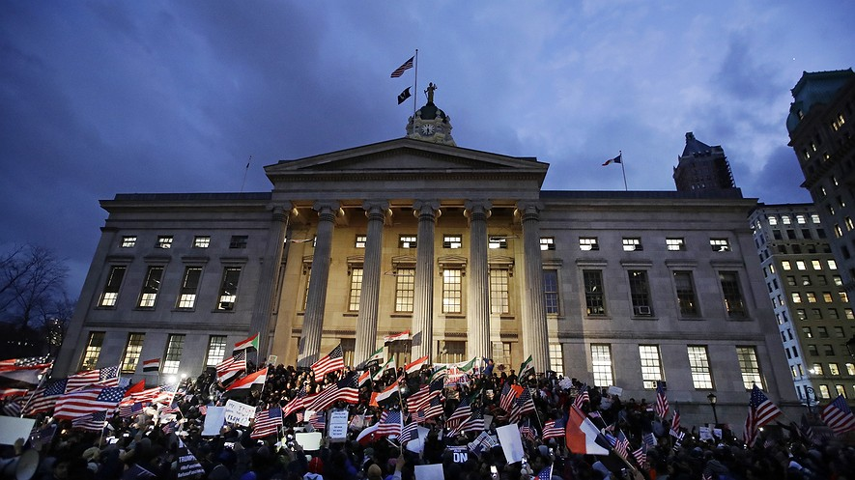
Court of appeals rules against travel ban,
Trump tweets "SEE YOU IN COURT"
The fight over President Donald Trump's travel ban is on pause. Trump issued a short-term order at the end of January. It did not allow people from seven countries to come to the United States. Many people thought Trump was being unfair to Muslims. They thought he was discriminating against their religion. This would be against the Constitution. Trump said he was not discriminating. He said the ban would keep terrorists out of the United States. He said he was making the country safer. Many people do not believe Trump. Washington state and Minnesota filed a lawsuit. The states said that Trump's ban is against the law. They also said it not constitutional. A judge in Washington state stopped the ban for a little while. People from the seven countries are allowed to travel to the United States again. It is unclear what Trump's next move will be. The president could ask a larger panel to hear the case. Or, the case could go to the Supreme Court. For now, travelers with the correct paperwork can come to the United States.
Source:https://newsela.com/articles/travel-ban-appeals-court/id/26856/

Slide 5
Thoughts?

Slide 6
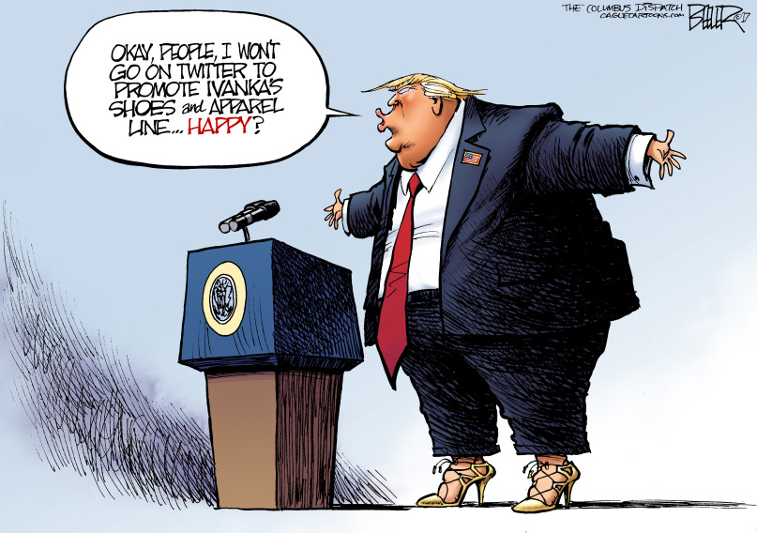
Thoughts?

